Slide 1



PR-report 24th Azerbaijan International Food Industry Exhibition 12th Azerbaijan International Agriculture Exhibition Caspian International Packaging, Tare, Label and Printing Exhibition
Prepared by PR-assistant
Shovkat Hasanova

Slide 2
PR report
Press Conference
Media Monitoring
Newspapers
VIP
Tour
TV
Internet Portals
Radio

Slide 3
Statistics
Of the WorldFoodAzerbaijan, Caspian Agro & IpackCaspian exhibitions:
39 articles were published in 34 Newspapers and 5 Magazines
444 news were published in 120 Internet Portals
9 TV channels showed the video about the exhibitions 34 times in daily news
3 Radio channels voiced advertising and 10 interview

Slide 4
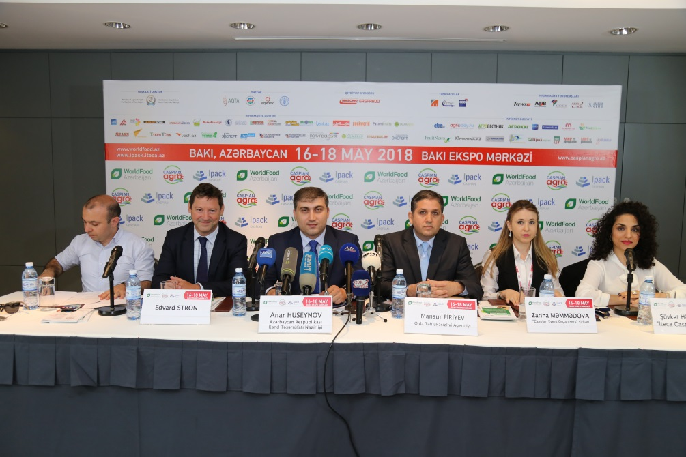
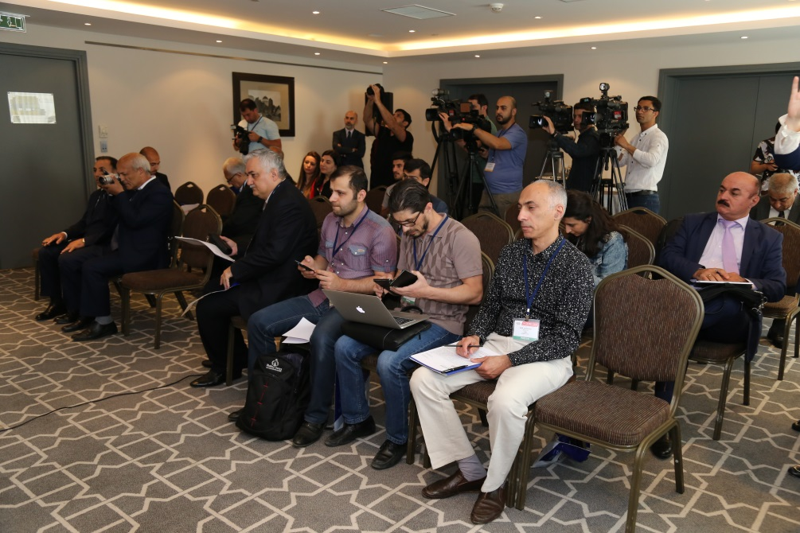
Press Conference
The press conference dedicated to the opening of the 24th Azerbaijan International Food Industry, the 12th Azerbaijan International Agriculture and Caspian International Packaging, Tare, Label and Printing exhibitions took place on May 15, at 12:00 a.m. at the Hyatt Regency hotel.
The press conference was attended by Mr. Anar Huseynov - Head of Information and Public Relations Department of the Ministry of Agriculture of the Republic of Azerbaijan, Mr. Mansur Piriyev - Head of the Communication and Information Technologies Department of the Food Safety Agency, Mr. Edward Strachan - Regional Director of ITE Group and Ms. Zarina Mammadova - Project manager. 30 media representatives attended the press-conference from AzTv, ARB, CBC, Iran TV, Lider, TREND, Azertag, APA, Report, Sputnik, Salamnews, 1news and others.

Slide 5
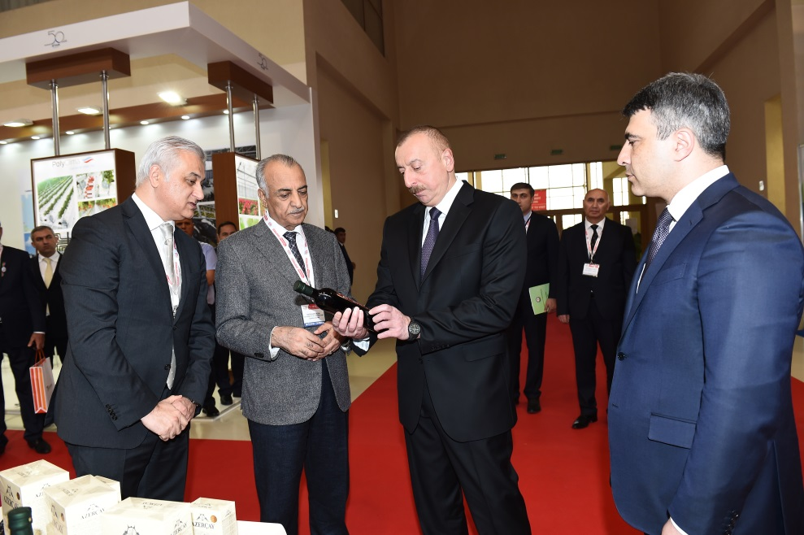
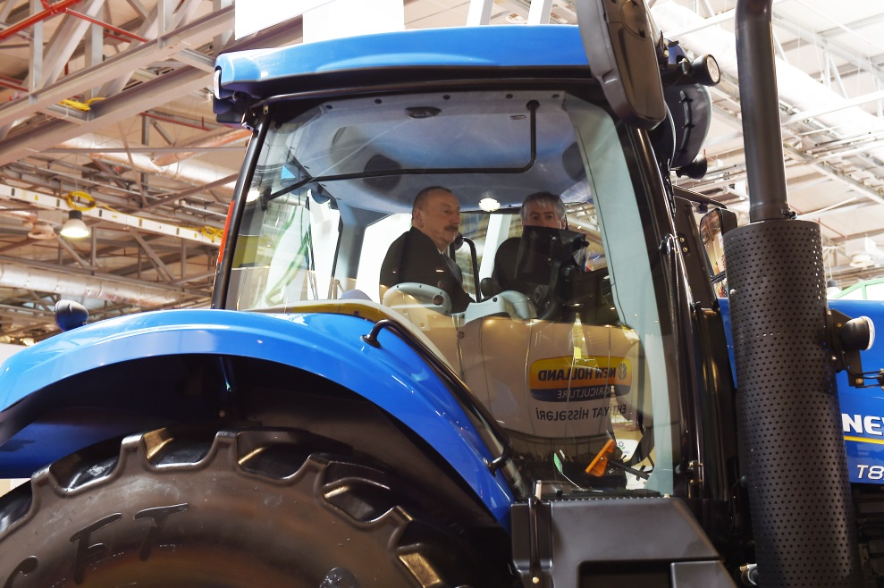
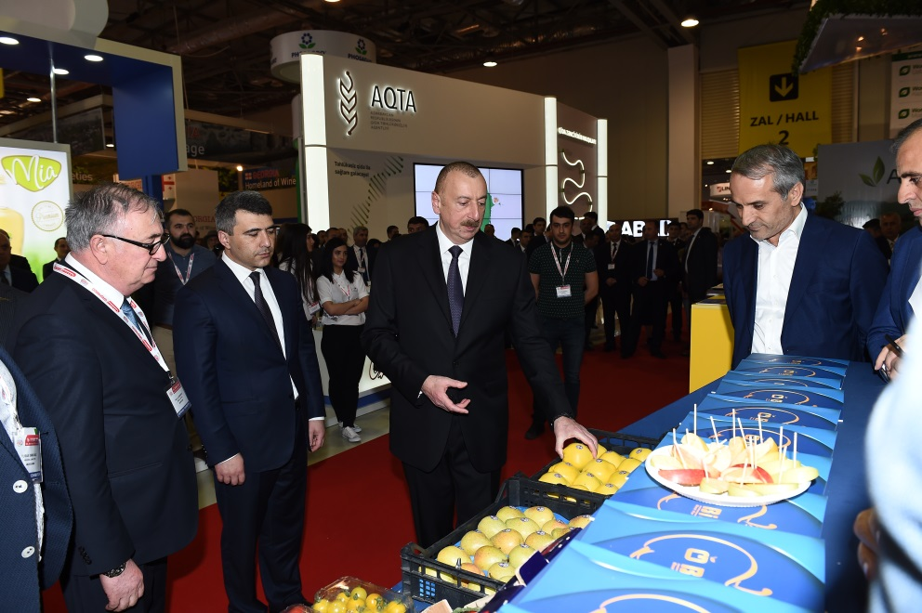
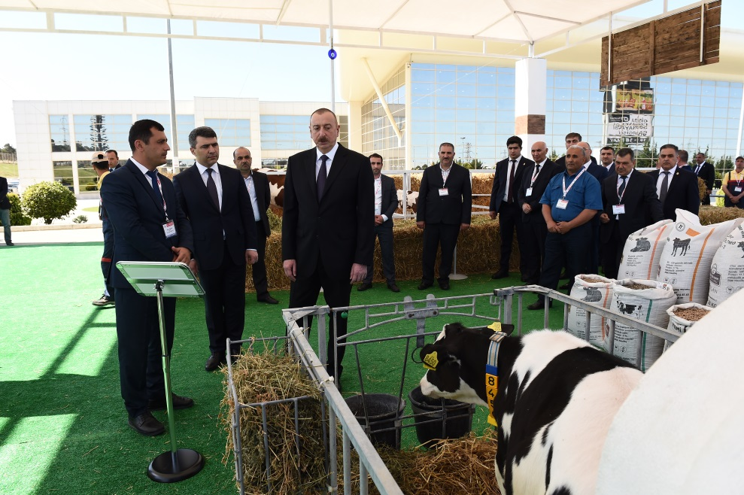
Official visit of the President

Slide 6
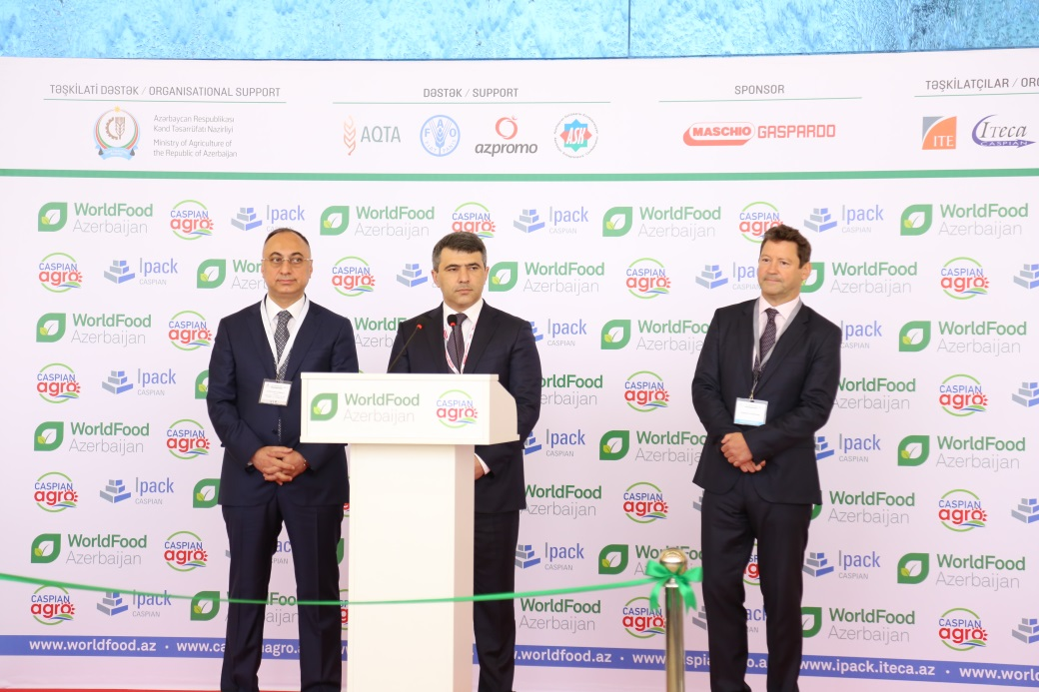
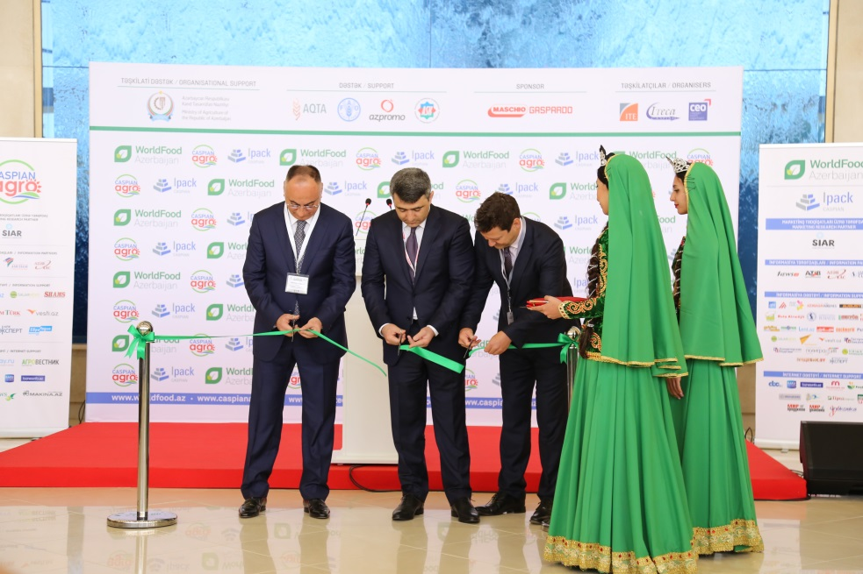
Opening Ceremony
The opening ceremony of WorldFood Azerbaijan, CaspianAgro and IpackCaspian exhibitions was held on 16 May at 10:00 at Baku Expo Center.
The official opening ceremony of the exhibitions took place with participation of:
Mr. Inam Karimov - Minister of Agriculture of the Republic of Azerbaijan
Mr. Goshgar Tahmazli - chairman of the Food Safety Agency
Mr. Edward Strachan - Regional Director of ITE Group

Slide 7
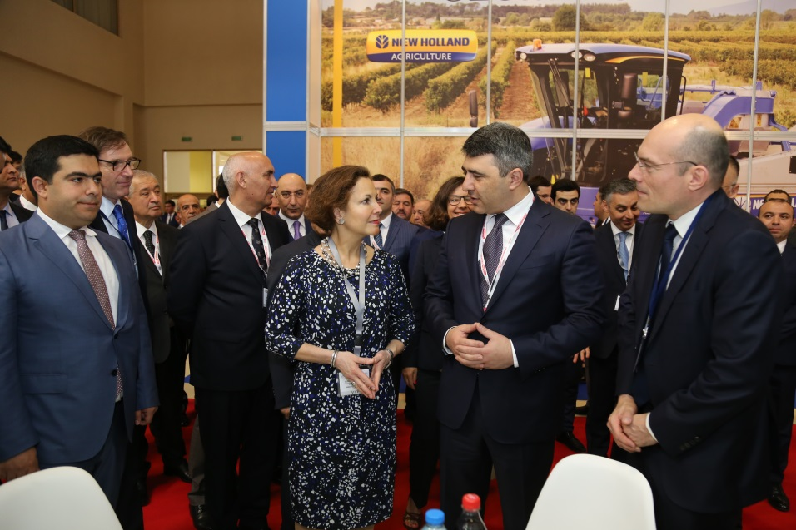
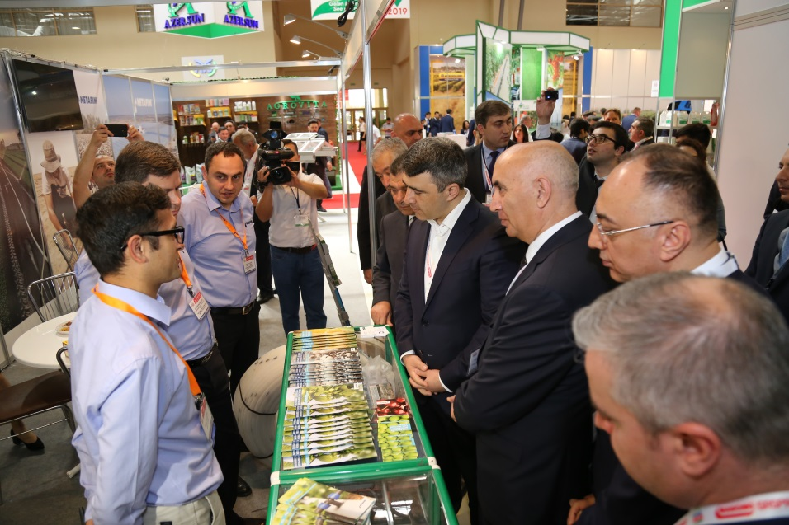
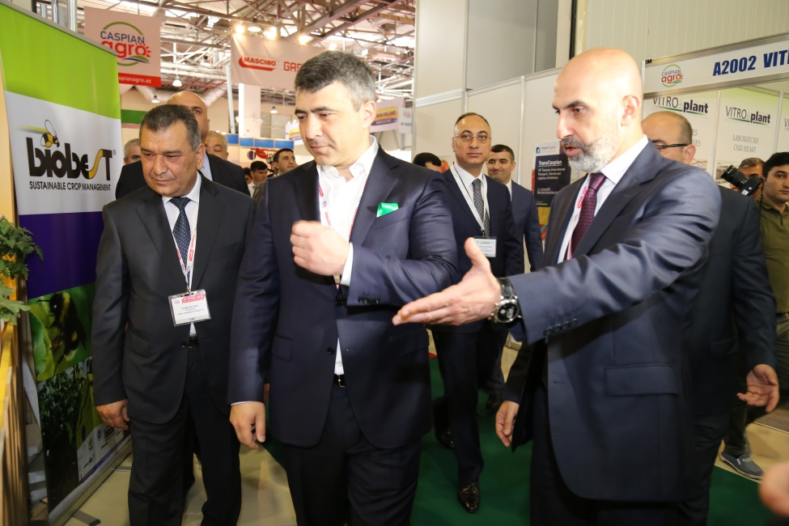
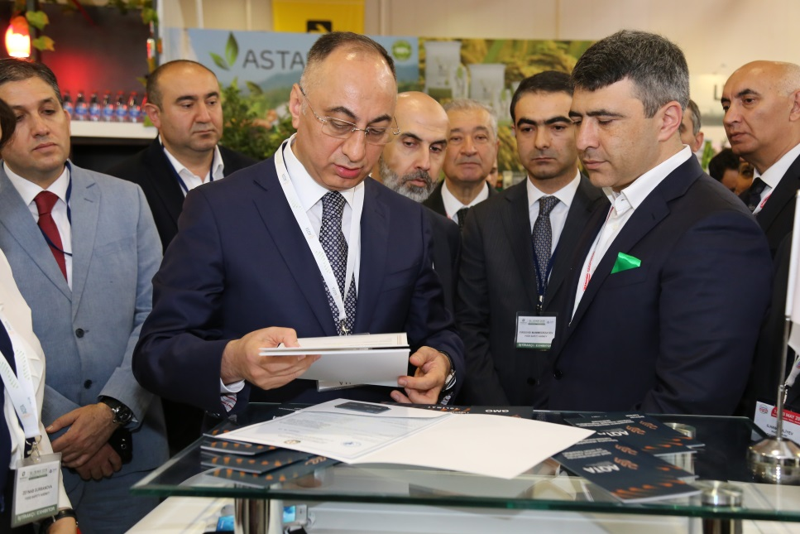
VIP Tour

Slide 8
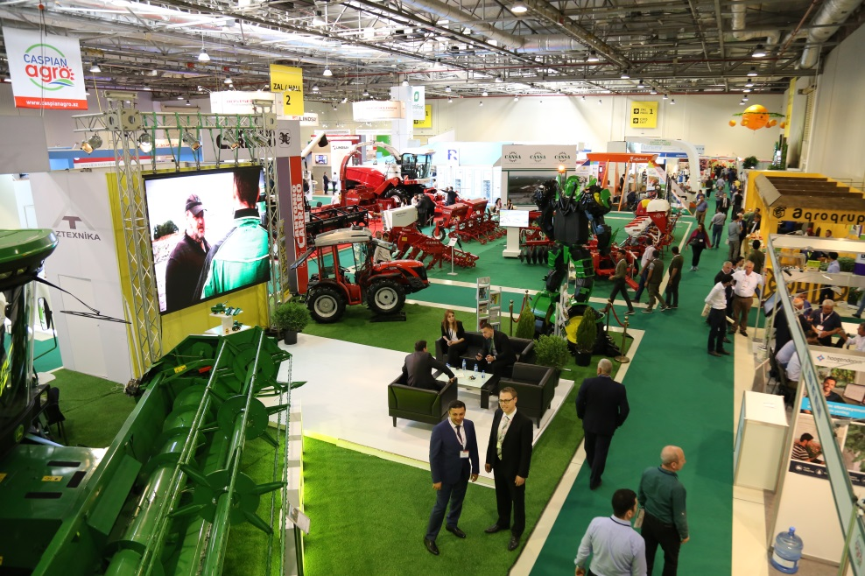
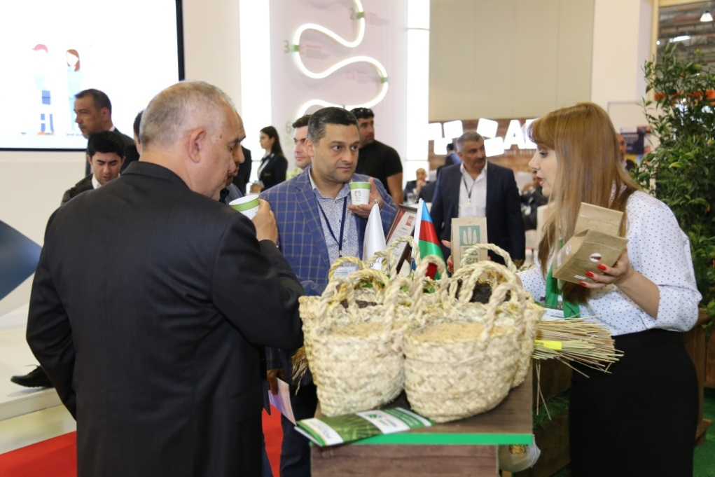
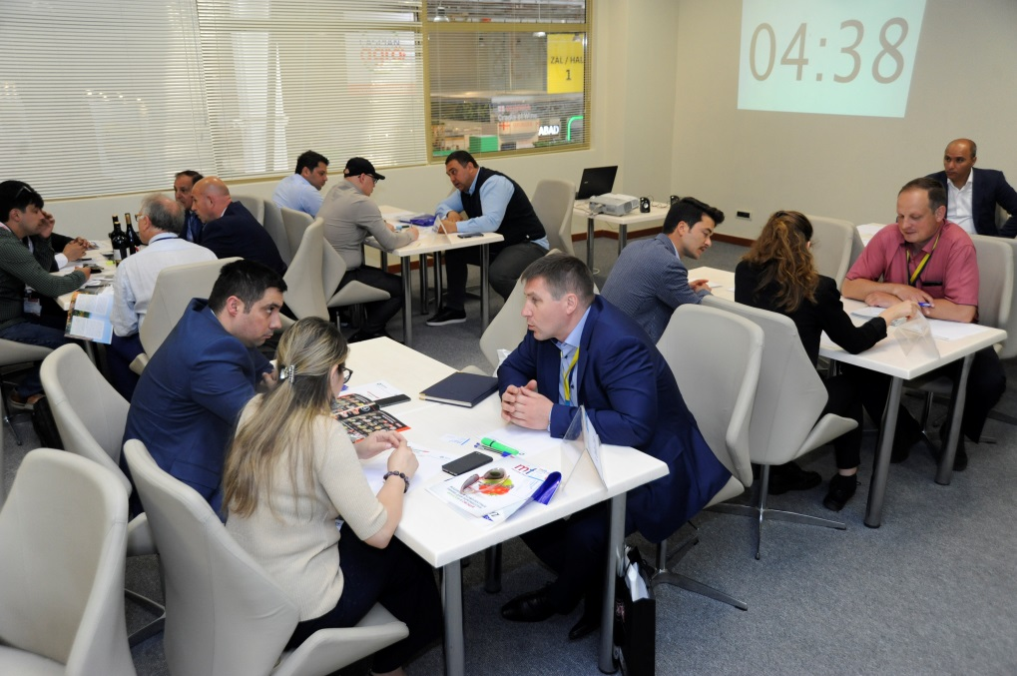
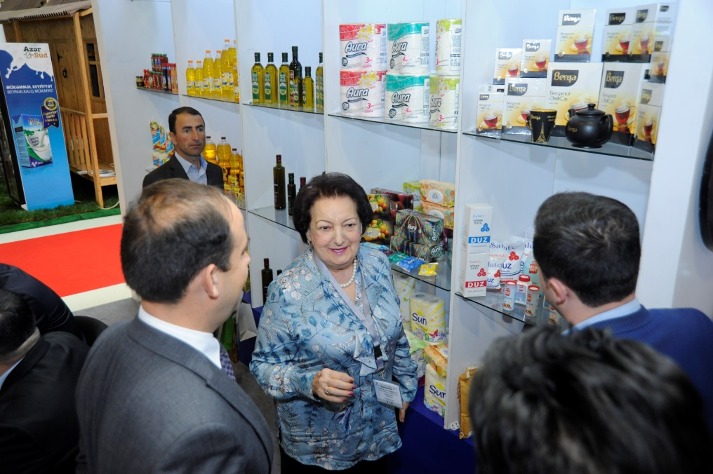

Slide 9
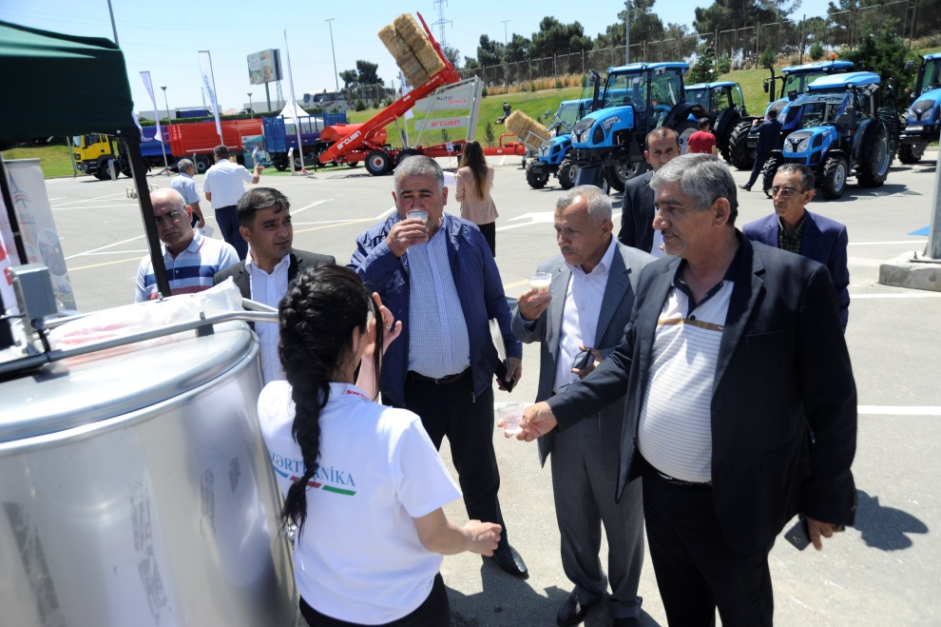
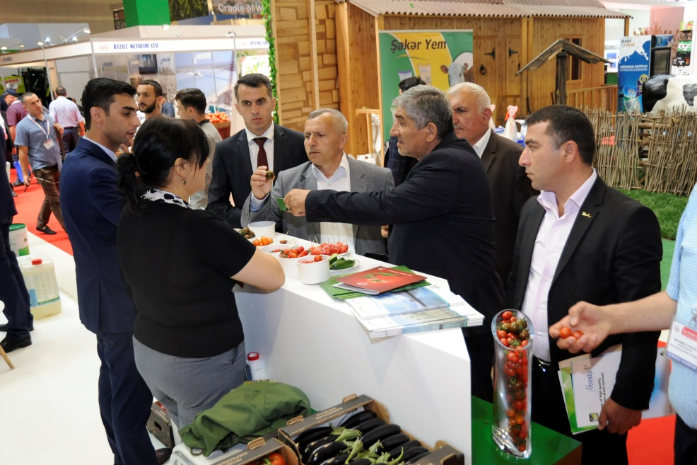
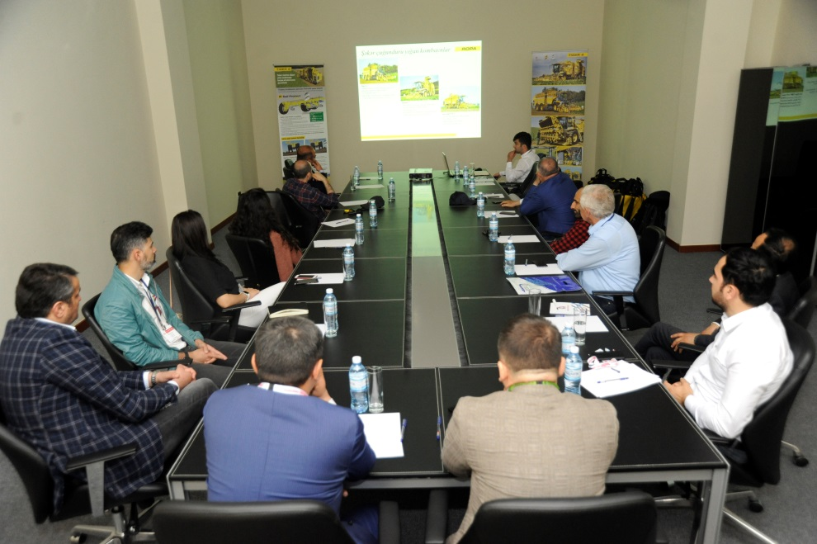
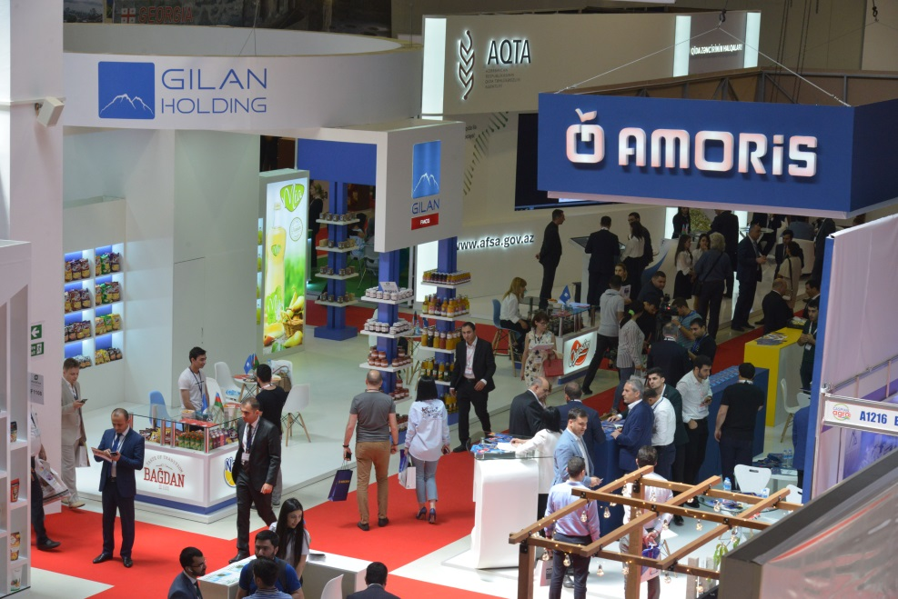

Slide 10

Media Monitoring

Slide 11

Newspapers
525-ci Qazet
Adalet
Azerbaycan
Azerbaycanskiye Izvestiya
Bizim Yol
Ejednevniye Novosti
Hefte Ici
Hurriyyet
Iki Sahil
Kaspi
Nedelya
Novoye Vrema
Paralel
Palitra
Respublika
Uc Noqte
Ses
Vishka
Xalq Cebhesi
Yeni Azerbaycan

Slide 12
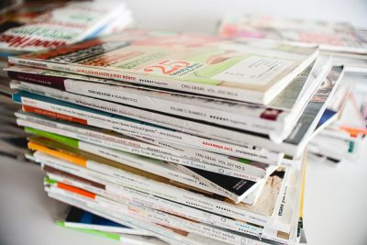
Magazines
Consulting and Business
Food Sektor Dergisi
Poland Fruit
Agrarnaya tema
Vestnik APK

Slide 13
TV monitoring
Date | Time | Channels
15.05.2018 | 14:29 | AzTV
15.05.2018 | 15:35 | ARB
15.05.2018 | 19:35 | Lider
16.05.2018 | 07:57 | ARB
16.05.2018 | 14:03 | CBC
16.05.2018 | 15:00 | ITV
16.05.2018 | 15:00 | Real TV
16.05.2018 | 17:05 | Xezer
16.05.2018 | 17:15 | CBC
16.05.2018 | 19:05 | Lider
16.05.2018 | 19:35 | Lider
16.05.2018 | 20:12 | AzTV
16.05.2018 | 20:22 | Space
16.05.2018 | 20:30 | ATV
16.05.2018 | 20:38 | ITV
16.05.2018 | 20:42 | AzTV
16.05.2018 | 20:50 | ATV
16.05.2018 | 21:00 | Xezer
16.05.2018 | 21:01 | ITV
16.05.2018 | 21:03 | Real TV
16.05.2018 | 21:09 | Real TV
16.05.2018 | 21:30 | CBC
16.05.2018 | 23:38 | ARB
16.05.2018 | 23:55 | ARB
17.05.2018 | 08:54 | AzTV
17.05.2018 | 17:25 | CBC
17.05.2018 | 20:30 | Space
17.05.2018 | 21:15 | Real TV
18.05.2018 | 08:33 | AzTV
19.05.2018 | 08:58 | AzTV
20.05.2018 | 19:20 | ATV
20.05.2018 | 20:40 | AzTV
20.05.2018 | 21:28 | CBC
20.05.2018 | 21:28 | ITV

Slide 14
Radio Monitoring
Date | Time | Radio Station
16.05.2018 | 11:00 | Asan Radio
16.05.2018 | 12:00 | Asan Radio
16.05.2018 | 14:00 | Asan Radio
16.05.2018 | 15:00 | Asan Radio
16.05.2018 | 15:00 | Araz Radio
16.05.2018 | 15:00 | Lider FM
16.05.2018 | 16:00 | Asan Radio
16.05.2018 | 16:00 | Lider FM
16.05.2018 | 19:00 | Asan Radio
16.05.2018 | 19:00 | Lider FM

Slide 15
Internet portals
http://www.azerbaijan-news.az/index.php?mod=3&id=147306
http://teleqraf.com/news/siyaset/174012.html
https://tia.az/qida-təhlukəsizliyi-agentliyində-sahibkarlarla-gorus-kecirilib/
http://www.palitranews.az/news.php?id=86621
http://www.yeniazerbaycan.com/SonXeber_e33460_az.html
https://azertag.az/xeber/Azerbaycan_narinin_ixracinin_artirilmasi_meseleleri_muzakire_olunub-1169346
http://azinforum.az/aktual/azərbaycan-narinin-təbligati-ilə-bagli-umumrespublika-yigincagi-fotolar/
http://xalqinfo.az/iqtisadiyat/74472-azrbaycan-narnn-tbliat-il-bal-mumrespublika-ynca-.html
http://advis.ru/php/view_news.php?id=97133116-B1D9-B642-92CC-9AAA3377356F
http://advis.ru/php/view_news.php?id=D5FD7880-7456-7F46-953E-F179C7A8F068
http://xalq.az/bizim-planet-də-prezident-ilham-əliyevin-naxcivana-səfəri-muzakirə-olundu/
http://azpress.az/index.php?lang=az&sectionid=news&id=80636
http://az.strategiya.az/index.php?do=xeber&id=123047
http://azadinform.az/news/print-173745.html
http://ucnoqta.az/news/64502
http://www.mia.az/w278643/.../
http://metbuat.az/news/954782/prezident-ilham-eliyevin-naxcivana-seferi-muzakire-olundu.html
http://www.avropa.info/az/post/253408.html
http://advis.ru/php/view_news.php?id=0EB775C4-9B6B-6640-833F-2E347F40BEF4
http://oxu.az/politics/256929
http://oxu.az/economy/256884
http://ru.sputnik.az/economy/20180518/415392726/prodovolstvennaja-bezopasnost-registracija-predprinimatelej.html
http://www.yeniazerbaycan.com/SonXeber_e32841_az.html
https://azertag.az/xeber/Qida_Tehlukesizliyi_Agentliyinin_sedri_sahibkarlarla_gorusleri_davam_etdirir-1164188
http://musavat.com/news/bakida-eyni-vaxtda-3-boyuk-sergi-kecirilib-fotolar_527713.html
Total: 444 articles

Slide 16
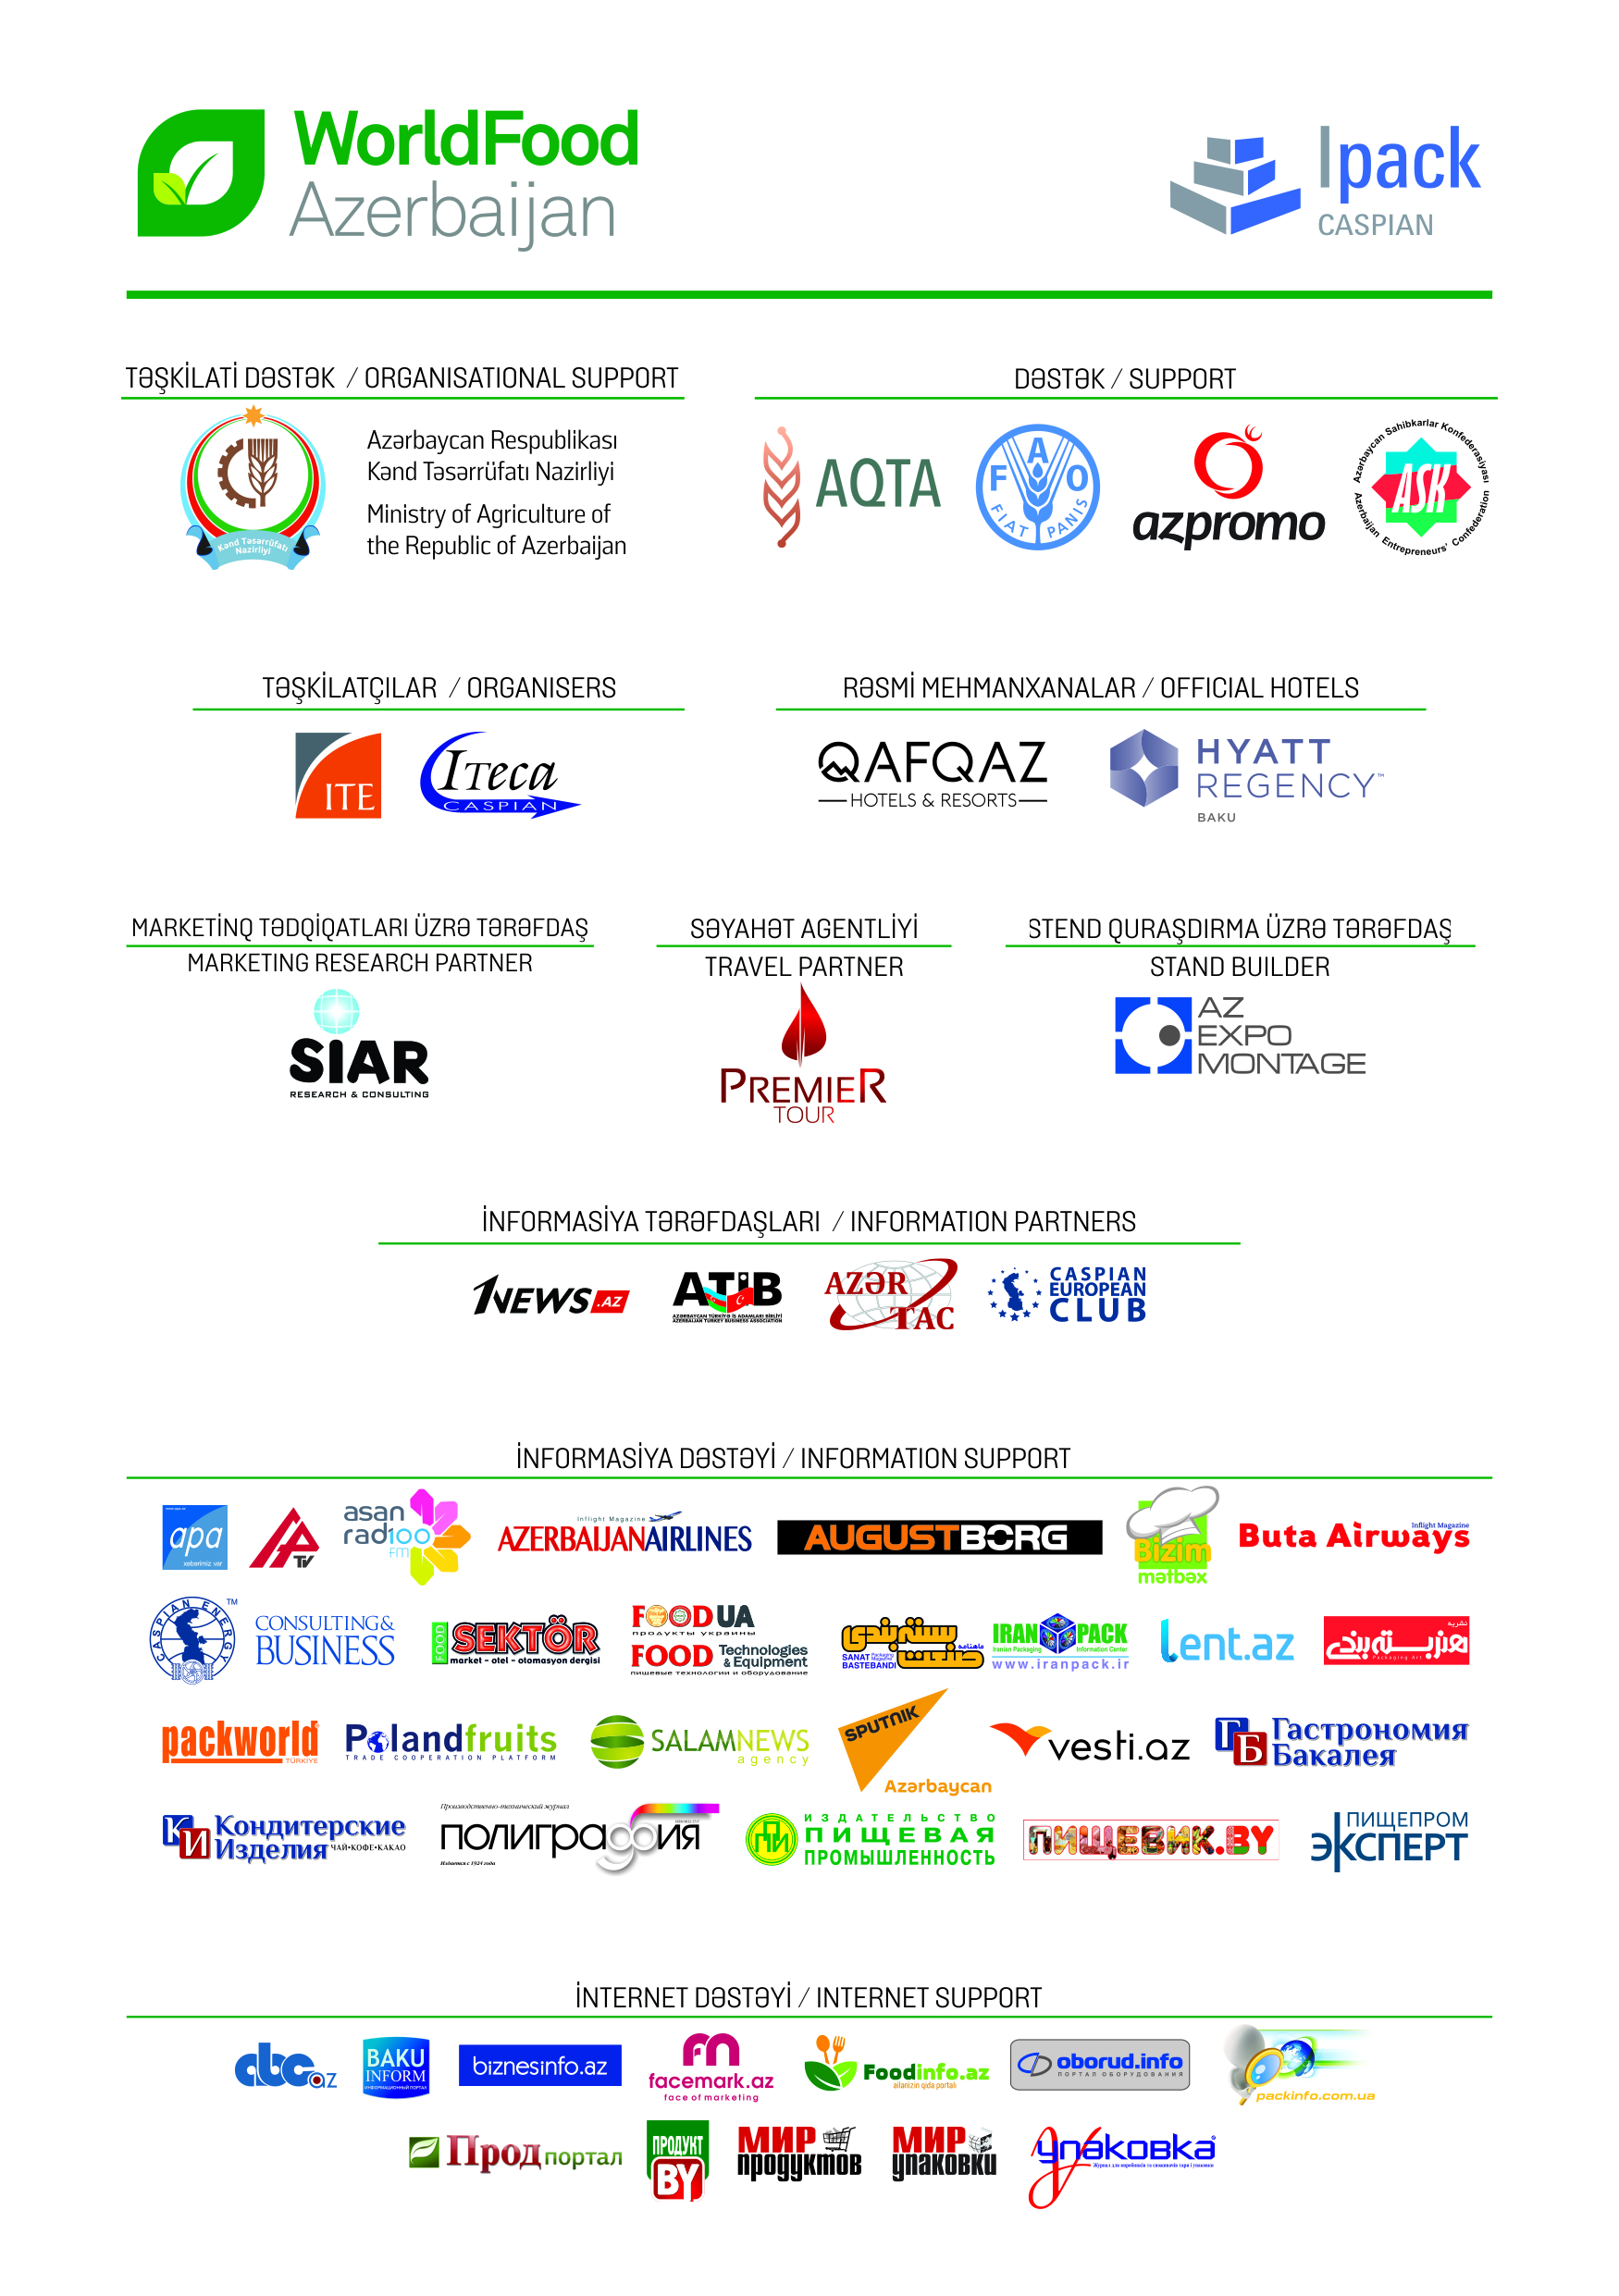
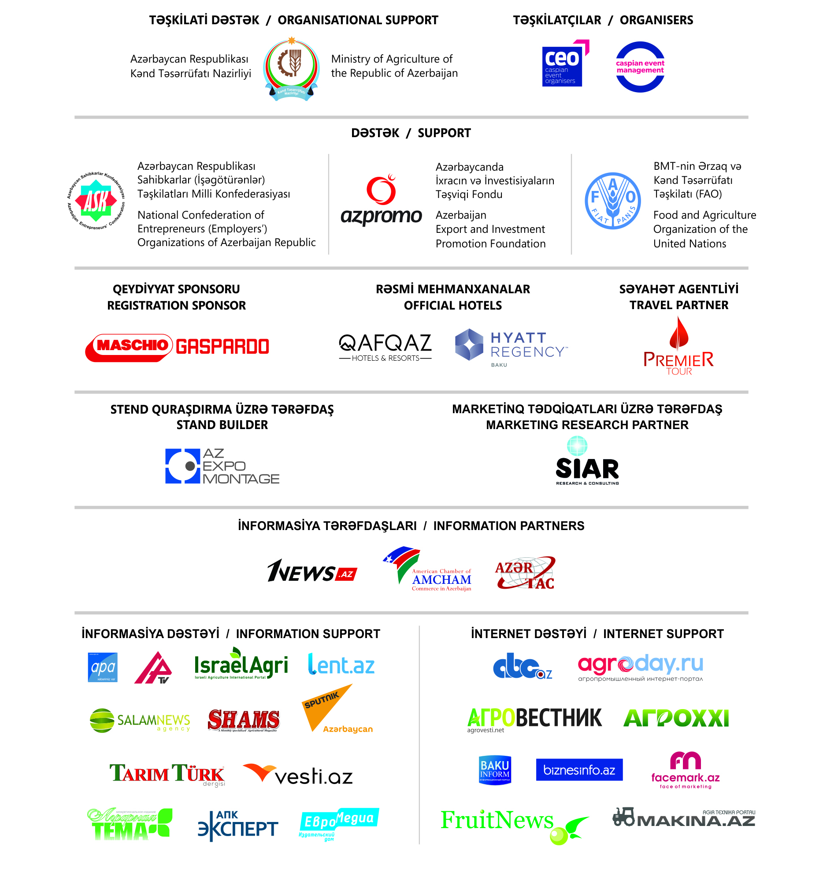

Slide 17

Watch us on YouTube channel:
https://www.youtube.com/user/ItecaCaspian
https://www.youtube.com/channel/UCjHIH7Zs_qIEpyJx3HbhIrA

Slide 18


Total number of WorldFood Azerbaijan 1 120
Total number of Caspian Agro 227

Slide 19


SEE YOU IN 2019!

